Slide 1

Introduction

Slide 2
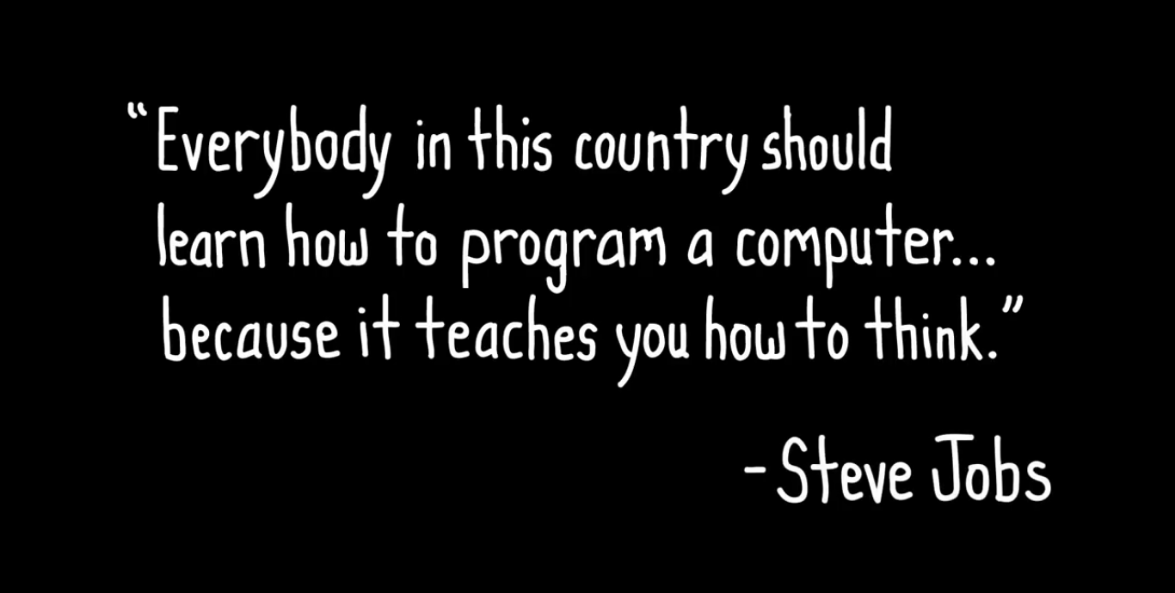
Why Should You Learn to Code?

Slide 3

Why Should You Learn Javascript?
1. Easy to start with
2. Great career oportunities
3. Wide range of usage
4. Big community
5. lots of sources to learn

Slide 4
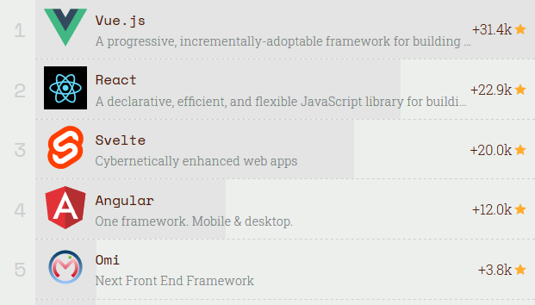
Top JS Front–End Frameworks 2019
https://risingstars.js.org/2019/en/

Slide 5
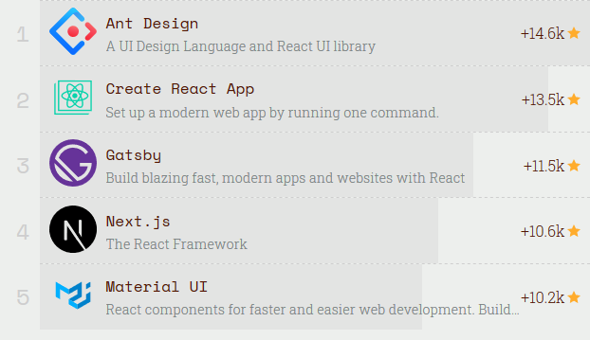
Top React Ecosystem 2019
https://risingstars.js.org/2019/en/

Slide 6
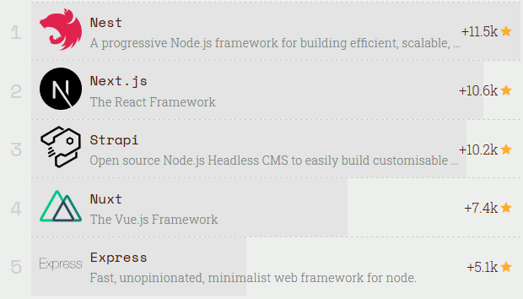
Top Node JS Back-End Frameworks 2019
https://risingstars.js.org/2019/en/

Slide 7
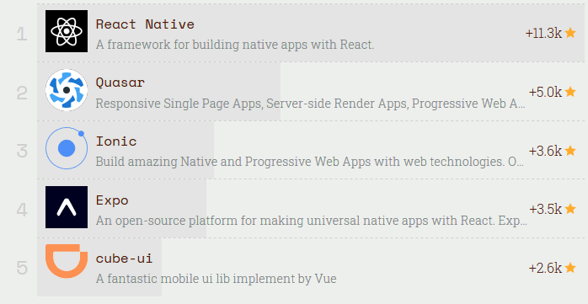
Top JS Mobile Frameworks 2019
https://risingstars.js.org/2019/en/

Slide 8
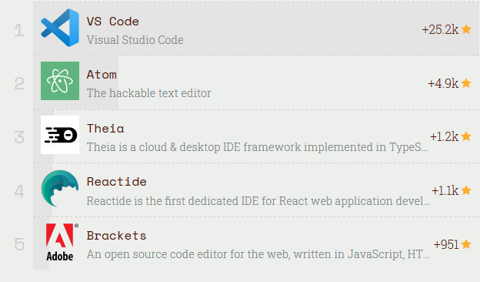
Top Code Editor 2018
https://risingstars.js.org/2018/en/

Slide 9
JavaScript often abbreviated as JS, is a high-level, dynamic, weakly typed, object-based, multi-paradigm, and interpreted programming language.
Alongside HTML and CSS, JavaScript is one of the three core technologies of World Wide Web content production.

Slide 10

Node.js® is a JavaScript runtime built on Chrome's V8 JavaScript engine. Node.js uses an event-driven, non-blocking I/O model that makes it lightweight and efficient. Node.js' package ecosystem, npm, is the largest ecosystem of open source libraries in the world.

Slide 11


SetUp
Visual Studio Code
Download & install here:
code.visualstudio.com
Node.Js
Download & install here:
nodejs.org
$ node --version
$ node -v

Slide 12
Make your first JS file #1
<Running Node Shell on prompt #1>
* Buka terminal <run cmd>
* Ketik node lalu enter
* Ketik program & enter untuk eksekusi
* Ketik process.exit() untuk keluar
console.log('Halo');

Slide 13
Make your first JS file #2
<Running on command prompt #2>
console.log('Halo');
* Simpan sebagai file.js
* Buka terminal <run cmd>
* Masuk ke direktori file.js
* Eksekusi node file.js

Slide 14
Make your first JS file #3
<Insert JS on HTML>
<script>
console.log('Halo Dunia');
</script>
* Simpan sebagai file.html
* Buka file.html di browser
* Inspect & lihat hasil di tab console

Slide 15
Make your first JS file #4
<Insert JS on HTML, running on web page>
<script>
document.write('Halo Dunia');
</script>
* Simpan sebagai file.htm
* Buka file.htm di browser
* Hasil langsung terlihat di page

Slide 16
Make your first JS file #5
<inner HTML>
<p id="demo"></p> <script> document.getElementById("demo").innerHTML = 5 + 6; </script>
* Simpan sebagai file.htm
* Buka file.htm di browser
* Hasil langsung terlihat di page

Slide 17
Make your first JS file #6
<Running on browser, calling from HTML>
console.log('Halo');
* Simpan sebagai file.js
* Buat file HTML berikut (file.htm)
<script src="file.js"></script>
* Buka file.htm di browser
* Inspect & lihat hasil di tab console

Slide 18
Comment
// komentar 1 line
/*
komentar multiline
komentar multiline
komentar multiline
*/

Slide 19
dirname & filename
console.log(__dirname);
// menampilkan directory path
console.log(__filename);
// menampilkan file path

Slide 20
Variabel
var nama = 'Andi';
console.log(nama);
var usia;
usia = 22;
usia = 32;
console.log(usia);
let jomblo = true;
console.log(jomblo);

Slide 21
var vs let
var x = 21
var x = 22
console.log(x);
// output = 22
===========================
let y = 'hai' let y = 'halo' console.log(y);
// SyntaxError

Slide 22
Prompt & Alert
<write on HTML>
<script>
var kabar = prompt('Apa kabar?'); //muncul kotak dialog input
console.log(kabar); //tampilkan input di console
alert(kabar);
//tampilkan input di alert window
</script>

Slide 23
Solve It!
Buatlah sebuah aplikasi interaktif (user input) dengan prompt & alert, kemudian input dari user ditampilkan di console.

Slide 24
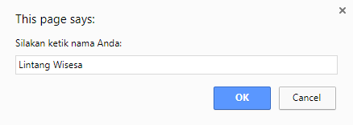
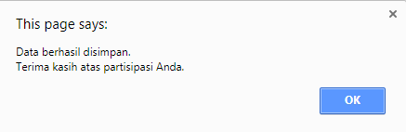

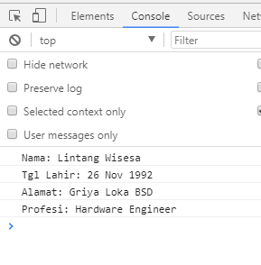
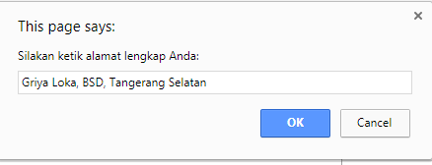

Solve It!

Slide 25
Solved!
<script>
var nama = prompt('Silakan ketik nama Anda:');
console.log('Nama: ' + nama);
var tglahir = prompt('Ketik tanggal lahir Anda:');
console.log('Tgl Lahir: ' + tglahir);
var alamat = prompt('Ketik alamat lengkap Anda:');
console.log('Alamat: ' + alamat);
var pendidikan = prompt('Ketik pendidikan terakhir:');
console.log('Pendidikan: ' + pendidikan);
var profesi = prompt('Silakan ketik pekerjaan Anda:');
console.log('Profesi: ' + profesi);
alert('Data berhasil disimpan. \n Terima kasih atas partisipasi Anda.');
</script>

Slide 26
Introduction

